Slide 1
WALKING BICYCLE
MSD PROJECT 2015-2018
PRESENTED BY
M3C-TEAM 07
K SAM JABA KUMAR NEC 15 15 146
S SHANMUGAVEL NEC 15 15 154
K SRIRAM NEC 15 15 172
K SURENDRA HNTC 1515005
S PRAKASH REDDY HNTC 1515011
1

Slide 2
CONTENTS
INTRODUCTION
OBJECTIVES
MECHANICAL DESIGN
WORKING DESCRIPTION
MODULAR BLOCK DIAGRAM
SCHEMATIC DIAGRAM
CIRCUIT DIAGRAM
INTERCONNECTION CIRCUIT
SOFTWARE USED
BILL OF MATERIALS
ADVANTAGES AND DISADVANTAGES
CONCLUSION
VIDEO

Slide 3

INTRODUCTION
A walking bicycle is a modern bicycle which is working under the combination of treadmill and bicycle mechanism.
With the help of the HUB motor the walking bicycle will work.
The HUB motor properly mounted beside the back wheel is used to push the treadmill and wheels of the bicycle in forward direction.
A HUB motor attached to the walking bicycle with spur gears which connects the conveyor with the help of chains. This mechanism makes the cycle to move forward directions.

Slide 4
OBJECTIVES
To control pollution.
To reduce the use of non-renewable energy sources.
To design an eco-friendly modern bicycle.

Slide 5
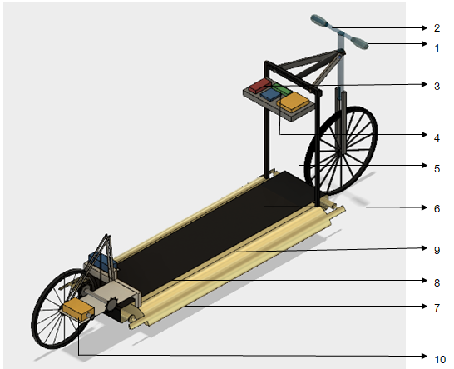
MECHANICAL DESIGN
1. HANDLE BAR
2. PULSE SENSOR
3. BATTERY
4. LCD DISPLAY
5. MICROCONTROLLER
6. POWER SUPPLY
7. CONVEYOR BED
8. CONVEYOR BELT
9. PIR SENSOR
10. HUB MOTOR

Slide 6
WORKING DESCRIPTION
Human will start walk on the treadmill. With the help of PIR sensor the motor will actuate and the bicycle will moving.
Speed sensor will sense the speed of the bicycle and display the speed of the walking bicycle in LCD display.
Once the walking bicycle stars moving the speed of the bicycle is controlled by the controller of the motor as per the speed required .

Slide 7
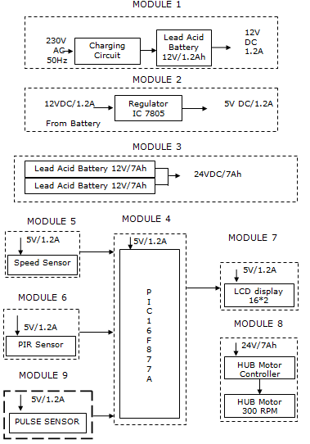
MODULAR BLOCK DIAGRAM

Slide 8
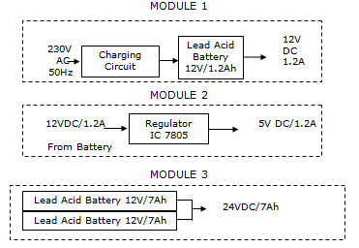
MODULE 1,2&3
Its constants of a 12V/2.5Ah lead acid batter and a charging circuit.
The desired output voltage for certain modules are obtained using a regulator.
The LM7805 provides an output of 5V/1.2A.

Slide 9
MODULE 4
PIC MICROCONTROLLER
Microcontroller PIC 16F877A from MICROCHIP Corporation
8 bit microcontroller
40 pin DIP package
Program memory capacity of 8kb
RAM of 368 bytes
256 bytes of EEPROM
Clock speed range of 0 Hz to 20 MHz

Slide 10
5 I/O ports named as PORTA, PORTB, PORTC, PORTD and PORT E
PORT A is 6 bit
PORT B is 8 bit
PORT C is 8 bit
PORT D is 8 bit
PORT E is 3bit
3TIMER
TIMER0(8bits)
TIMER1(16bits)
TIMER2(8bits)

Slide 11
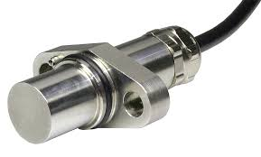
MODULE 5
Speed sensor constant of 5V/1.2A.
It is used to read the speed of the moving bicycle

Slide 12
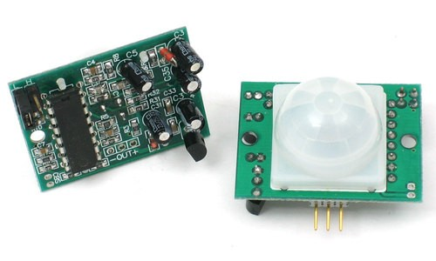
MODULE 6
PIR sensor constant of 5V/1.2A.
PIR sensor stands for Passive Infrared Sensor.
PIR sensor used for detecting the heat emitting bodies.
The control signal will be sent to the controller once the human is detected.

Slide 13
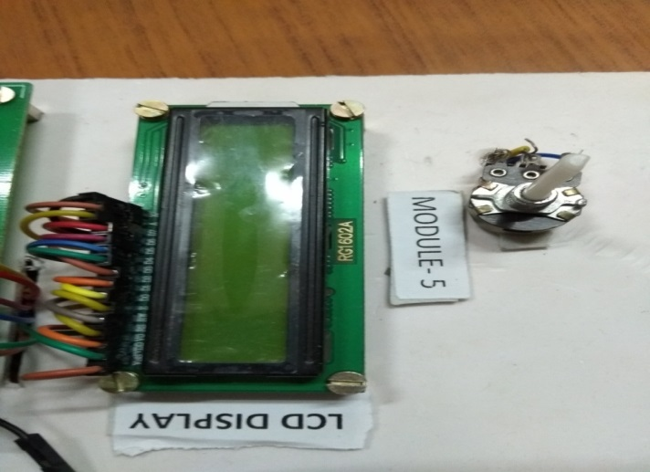
MODULE 7
LCD stands for liquid crystal display.
It is a flat panel display that uses the light modulating property of the liquid crystal.
It is used for displaying the pulse rate and overload indication.

Slide 14
MODULE 8
The HUB MOTOR is consist of 24V DC/2.5Ah.
A HUB MOTOR is an electrical motor coupled to the spur gears of a vehicle.
The HUB MOTOR is controlled by the accelerator.

Slide 15
MODULE 9
Pulse sensor is a well designed sensor for calculating the pulse per minute of the human and send to the microcontroller.
The sensor clips on to fingertip and plugs into the microcontroller.
It can be operated on 5V / 4mA.

Slide 16
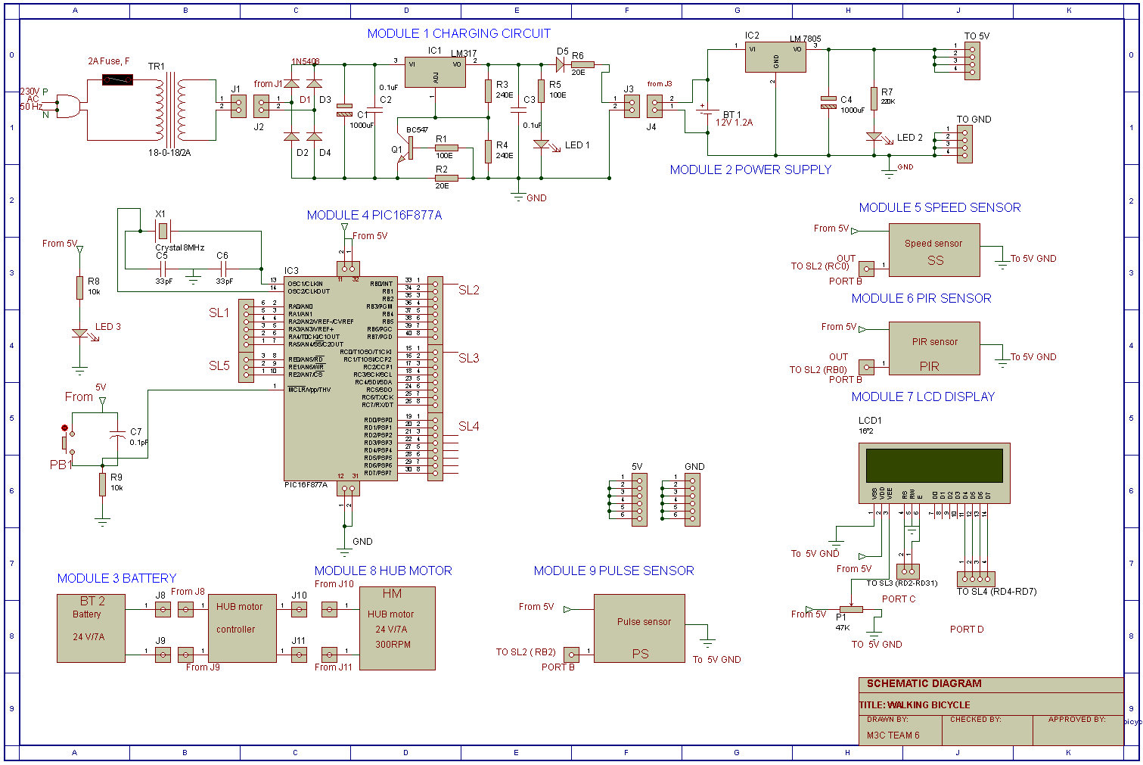
SCHEMATIC DIAGRAM

Slide 17
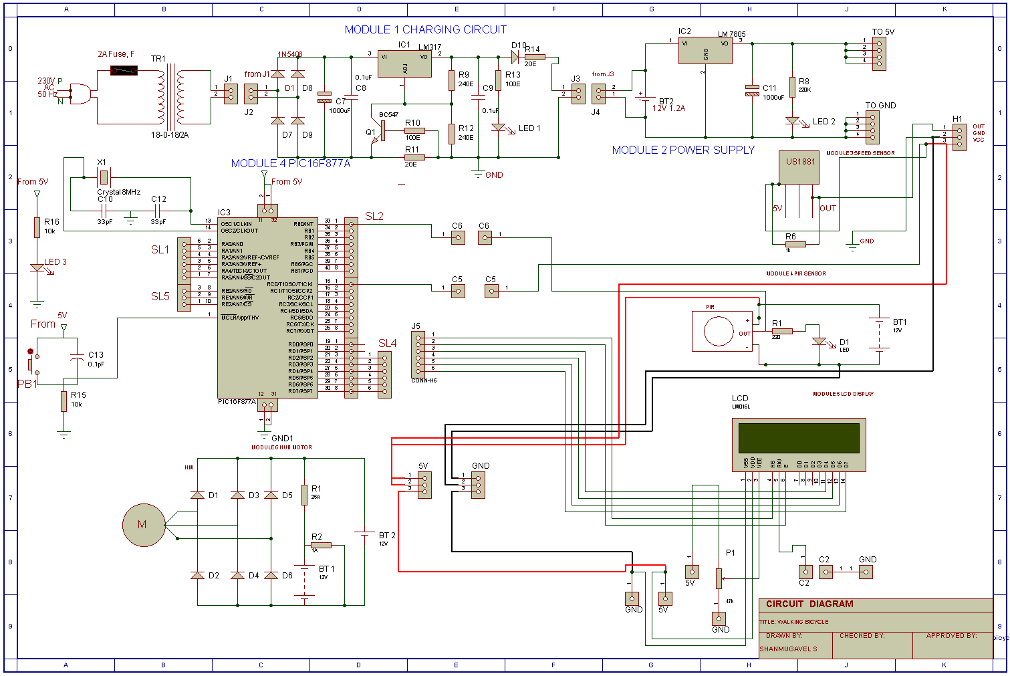
CIRCUIT DIAGRAM

Slide 18
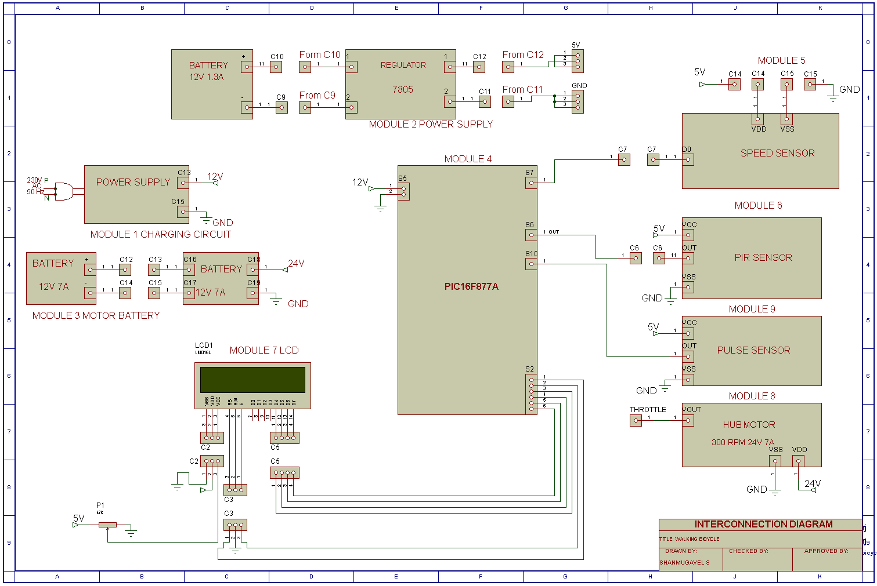
INTERCONNECTION DIAGRAM

Slide 19
SOFTWARE
Autodesk Fusion 360
Proteus
Mplab IBE
Paint

Slide 20
BILL OF MATERIALS
Bill of materials over all

Slide 21
ADVANTAGES
Pollution Controlled
Man power is used effectively
Controlling Is Easy

Slide 22
DISADVANTAGES
Not more then one can travel
Maintenance required

Slide 23
CONCLUSION
The system can be efficiently used anywhere whether it is outdoor
or indoor.
It utilizes highly fuel saving technology
Pedestrians in large campus can take benefit from this product

Slide 24
VIDEO
Walking Bicycle video

Slide 25



